Slide 1
TensorFlow on Kubernetes with GPU Enabled
Zeyu, Zheng, Chief Data Scientist, Caicloud
Huizhi, Zhao, Director of Engineering, Caicloud

Slide 2
Agenda
TensorFlow
Distributed TensorFlow
GPU capabilities in Kubernetes
TensorFlow on Kubernetes with GPU enabled
TensorFlow as a Service (TaaS)

Slide 3
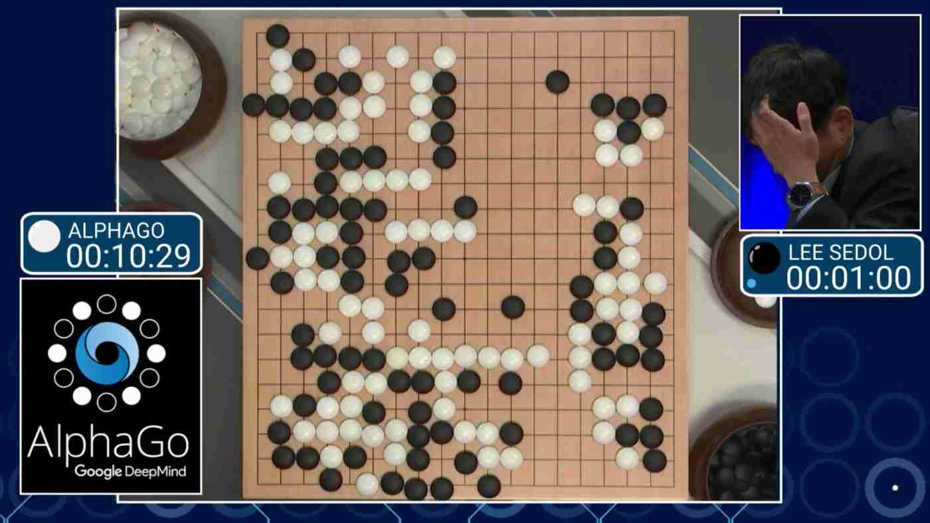
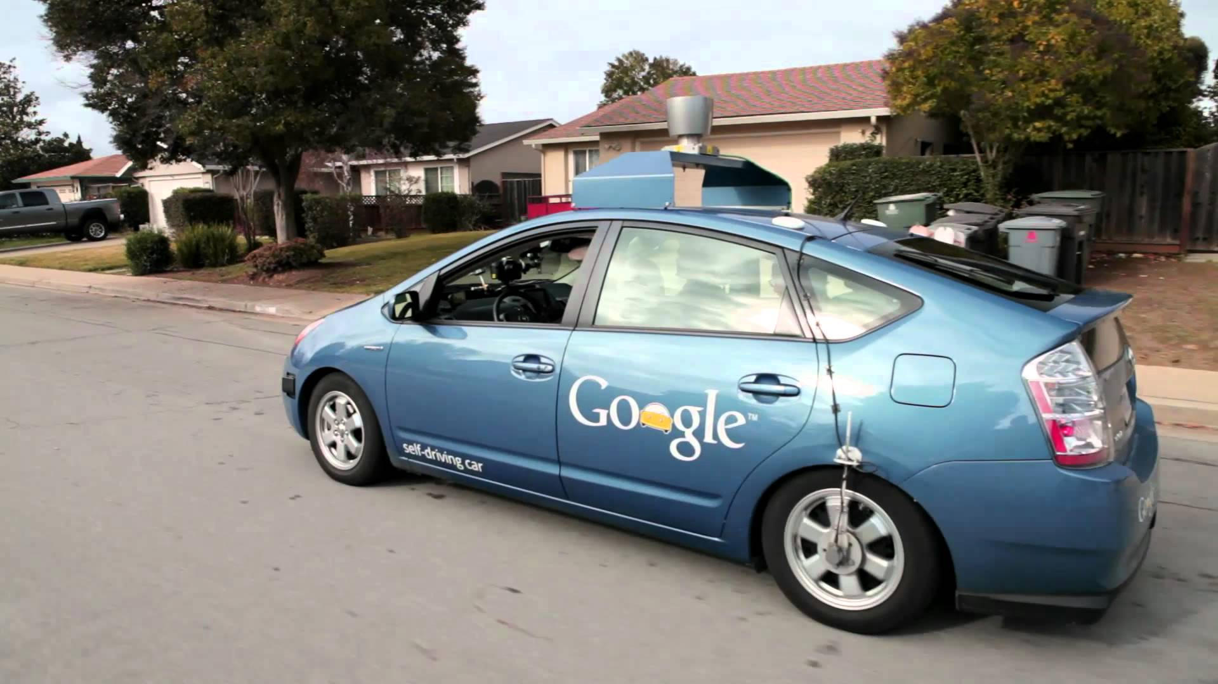
Deep Learning

Slide 4
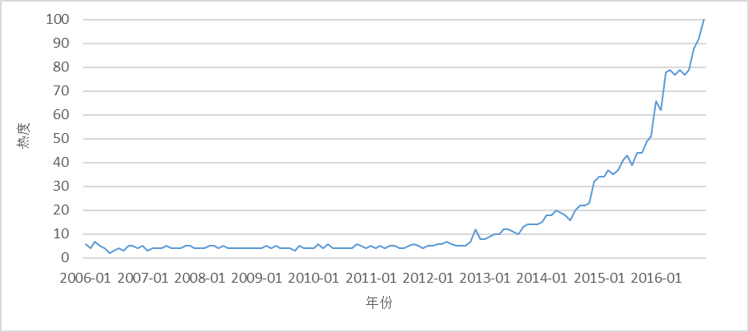
Deep Learning

Slide 5
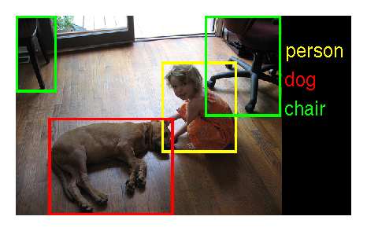
Deep Learning

Slide 6
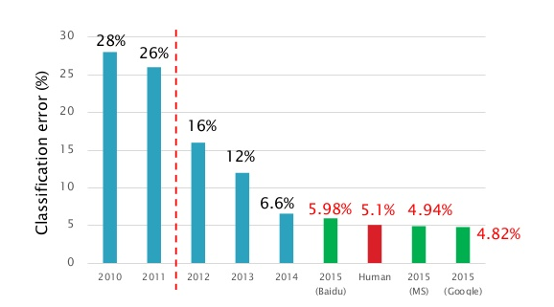
Deep Learning
Before
After

Slide 7
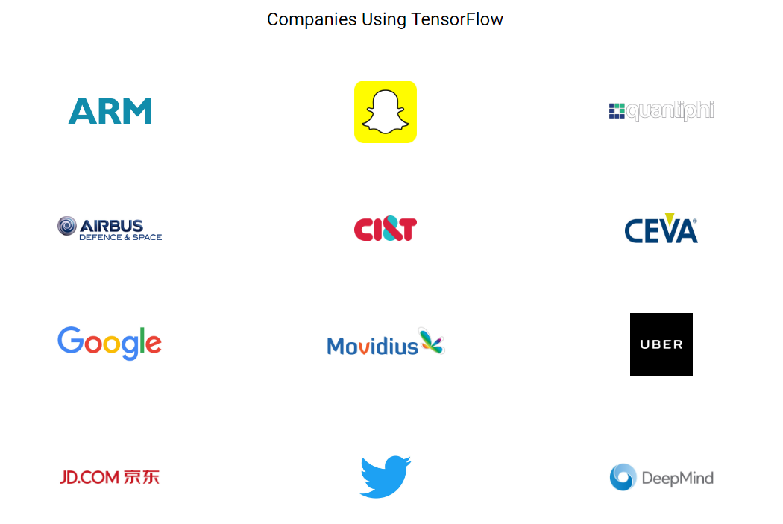
TensorFlow Introduction

Slide 8
TensorFlow Introduction

Slide 9
TensorFlow Introduction

Slide 10
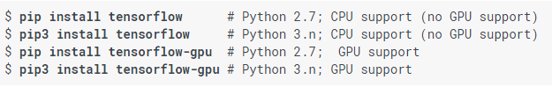
Deploy TensorFlow on 1 server
Please be aware of that TensorFlow already support Nvidia GPU
It is easy to deploy TensorFlow on 1 server (or on your laptop)
Nvidia GPU requirement:
GPU card with CUDA Compute Capability 3.0 or higher.
CUDA toolkit 7.0 or greater
cuDNN v3 or greater

Slide 11
Distributed TensorFlow environment
Reference: https://www.tensorflow.org/extend/architecture

Slide 12
Distributed TensorFlow with GPU enabled

Slide 13
Distributed TensorFlow causes management mayhem

Slide 14
GPU capabilities in Kubernetes
Device mapping in Docker
Discover GPUs in kubelet
Assign/free GPUs in kubelet
Schedule GPU resource in kube-scheduler

Slide 15
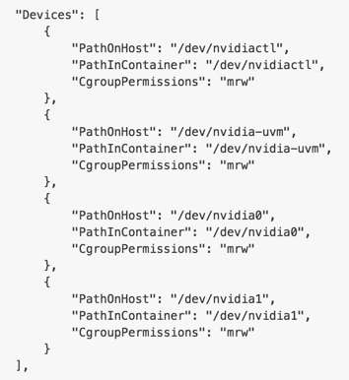
Device mapping in Docker
docker run -it --device /dev/nvidia0:/dev/nvidia0 \
--device /dev/nvidia1:/dev/nvidia1 \
--device /dev/nvidiactl:/dev/nvidiactl \
--device /dev/nvidia-uvm:/dev/nvidia-uvm \
tf-cuda:v1.1beta /bin/bash
Docker inspect

Slide 16
Discover GPUs in kubelet

Slide 17
Assign/Free GPUs in kubelet
Kubelet manage which GPUs should be
assigned to a new container. And reset the
GPU to free once the container killed/dead

Slide 18
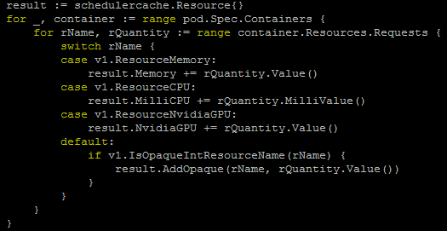
Schedule GPU resource in kube-scheduler
Kube-scheduler knows how many free GPUs on each kubelet.
2. Only dedicated GPUs support.
3. 1 GPU only can be assigned to 1 container now, but 1 container could has more than 1 GPU.

Slide 19
What should we do next?
CRI support
NVML support
GPU driver volume support
NCCL support

Slide 20
TensorFlow on Kubernetes

Slide 21
TensorFlow on Kubernetes with GPU enabled

Slide 22
Best practice
Reduce the network communication could save the bandwidth lack.
Use high frequency GPUs rather than GPUs for servers.
Always save your training and serving data on a volume rather than save them inside container, not only for the training and serving model, but also the training can recover and get the training steps.
Deploy multiple Parameter Server and deploy them on different server, it could balance the network.

Slide 23
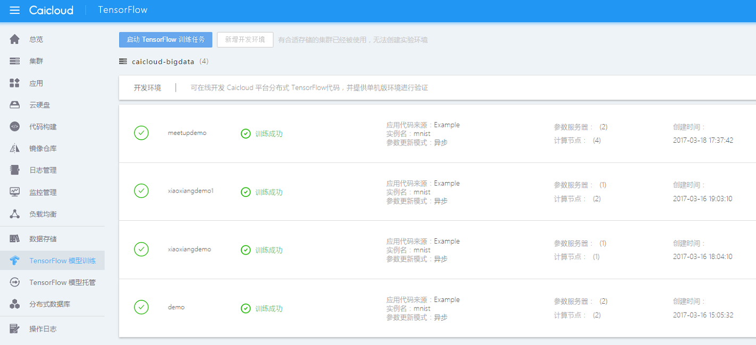
What is TensorFlow as a Service (TaaS)
TaaS = hosted, managed, and optimized TensorFlow with multiple developed models for real-world industrial solutions
网页截图

Slide 24
Compare with original TensorFlow environment
 | Operation | Original TensorFlow | Caicloud TaaS
Environment Setup | Single server | pip or docker image | Integrated Caicloud TaaS image.
 | Distributed environment | Setup server one by one | No need to do anything
 | Resource management | Usually, TensorFlow occupy all the resources | Based on Kubernetes, resources could isolated.
Module Training | Training | User need to config every parameter on each server | Upload your model file, config the parameter on the web UI.
Monitor Management | Monitor | Save logs and config TensorBoard manually | Save logs/config TensorBoard automatically
Model Serving | Model API serving | User need to implement it himself. | Export TensorFlow Model automatically, and support RESTful and gRPC model online serving

Slide 25
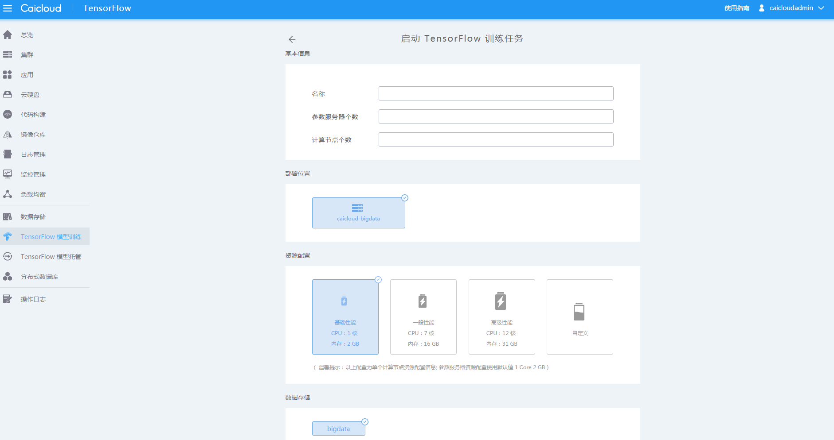
Main features – Training Configure

Slide 26
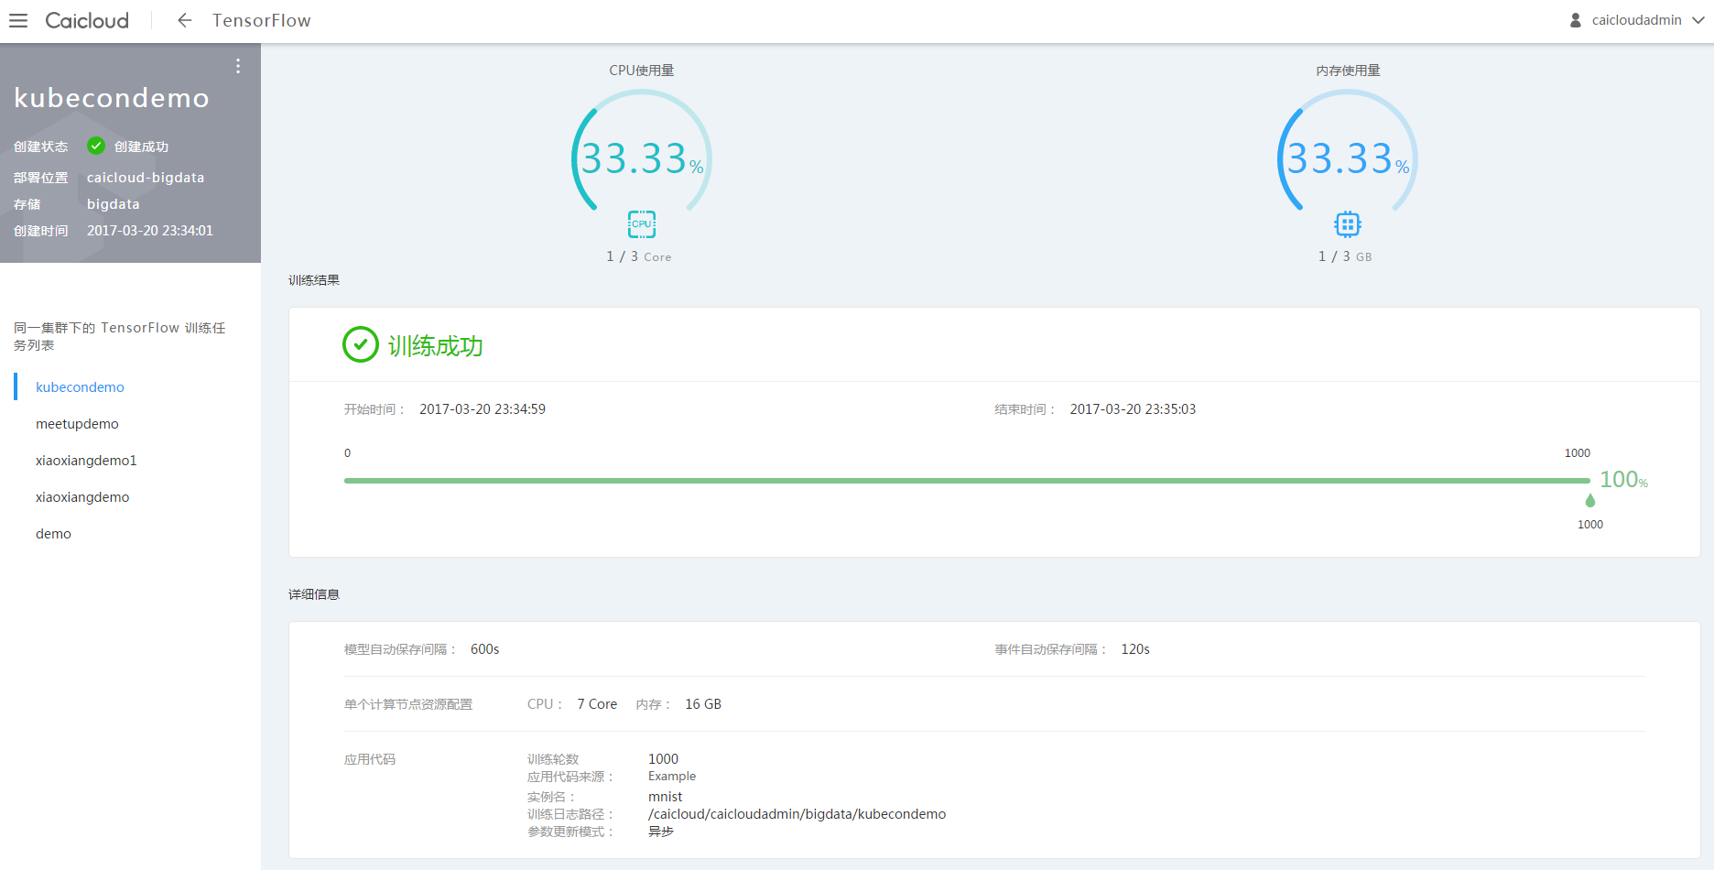
Main features – Training Monitor

Slide 27
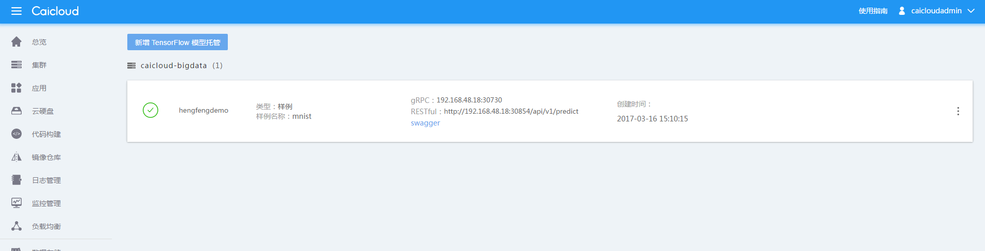
Main features - Model Serving Host

Slide 28
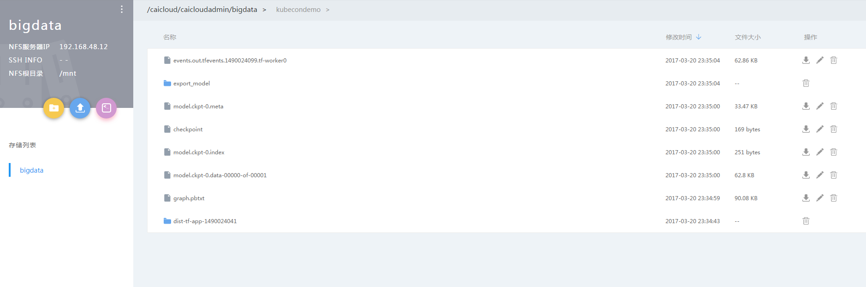
Main features - Storage

Slide 29
TaaS Training Resource Queue

Slide 30
TaaS Training Resource Pool

Slide 31
AI general case

Slide 32
What our company produce

Slide 33

Contract US
Facebook https://www.facebook.com/Caicloud-108906236310777/
Twitter https://twitter.com/Caicloud_io

Slide 34
Q & A
Thank you

